Slide 1
GHANA STOCK EXCHANGE (GSE) DASHBOARD REPORT
MARKET ANALYSIS REPORT: GHANA STOCK EXCHANGE (GSE)
Date of Report: March 8, 2026
Reporting Period: February 20 - February 26, 2026

Slide 2
Executive Market Summary
The Ghana Stock Exchange demonstrated robust bullish behavior during the trading session ending February 26, 2026. The market is characterized by strong upward momentum in major indices and high liquidity concentration in the banking sectors.

Slide 3
Key Investment Insights
The GSE Financial Index (GSE-FI) acted as the primary market driver, gaining +345.1 points, significantly outpacing the broader Composite Index. This suggests that the banking and insurance sectors (led by GCB, ACCESS, and EGH) are currently the preferred vehicles for capital appreciation.

Slide 4


Slide 5
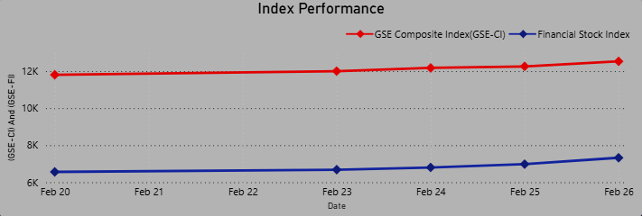
Key Investment Insights
Consistent Weekly Growth Trajectory

Slide 6
Key Investment Insights
Consistent Weekly Growth Trajectory
The "Index Performance" trend shows a "staircase" upward movement with no significant dips between February 20 and February 26. This technical pattern suggests a strong support level and sustained buying interest, rather than speculative volatility.

Slide 7
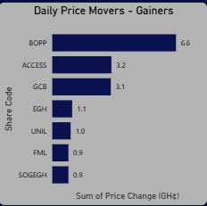
Key Investment Insights
Outsized Gains in BOPP

Slide 8
Key Investment Insights
Outsized Gains in BOPP
Benso Oil Palm Plantation (BOPP) was the day's top performer by price change, gaining over GH¢ 6.6 This is more than double the gains of the next highest mover (ACCESS), signaling potential sector-specific tailwinds in the agricultural or consumer goods space.

Slide 9
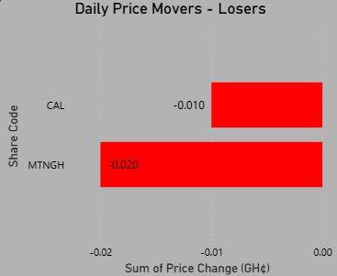
Key Investment Insights
Minimal Downside Volatility

Slide 10
Key Investment Insights
Minimal Downside Volatility
Market breadth was overwhelmingly positive. Only two stocks, MTNGH and CAL Bank, showed any downward movement, and these were marginal (nearly 0 GH¢). This indicates a lack of selling pressure and a "hold" sentiment among current shareholders.

Slide 11
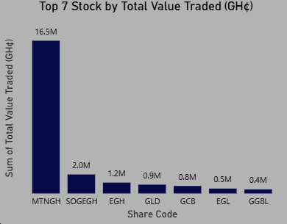
Key Investment Insights
Total Value of Shares Traded (Top 7 Stocks)

Slide 12
Key Investment Insights
Total Value of Shares Traded (Top 7 Stocks)
Following the growth and improved performance of the GSE Composite Index, trading activity on the Ghana Stock Exchange showed strong participation among leading equities. Among the top seven stocks by total value traded, MTNGH (MTN Ghana) emerged as the clear market leader with a total value of GH¢16.5 million worth of shares traded during the period

Slide 13
Technical Observations
Support/Resistance: The GSE Composite Index (GSE-CI) is comfortably holding above the 12,500 mark.
Breadth: The ratio of Gainers to Losers is approximately 5:2, with the magnitude of gains far exceeding the losses.

Slide 14
Recommendations
Focus on Financial Sector Investments
Investors looking for capital appreciation might think about expanding their exposure to the banking and insurance industries given the robust performance of the GSE Financial Index (GSE-FI) and the superior performance of major banks (GCB, Access Bank, and EGH).

Slide 15
Recommendations
Agricultural and Consumer Goods Growth Opportunities.
Significant gains at Benso Oil Palm Plantation (BOPP) indicate sector-specific growth. For possible short- to medium-term returns, investors may look into a few high-performing consumer products and agricultural stocks.

Slide 16
Thank You.

